Slide 1
IonDelivery V0.4
-- Arihant Prasad D (08th November, 2017)
Reviewed by: Vidya J, Abhinay A, Mritunjay s on __^{th} nov, 2017
Reviewed by: Manohar J on __^{st} nov, 2017

Slide 2
Scope of the Project
To design an IonDelivery Application software that can cater to the delivery mechanism of an academic institution needs to handle batches, Topic Design with methods to meet the course outcomes, generating progress reports, notifications to faculty on their pending task, notifications to students on their recommendation on their studies and other related services and also provide a robust students’ assessment tracking system.

Slide 3
Team members
Architecture, Database and User Interface Design Team
Abhinay Angadi
Arihant Prasad D
Mritunjay Shettar (Dev.)
Shivarajkumar Badiger (Dev.)
Development Team
Avinash P
Deepa N G
Sachin H S
Suchitra V
Pallavi G
Indira A
Aditya
Shashidhar
Ranjita

Slide 4

Modules Covered
Manage Course Instructor
Lesson Schedule
Assignment
Quiz
Share Course Materials
Project Execution
Feedback
Attendance
Time Table
Dashboard
Configuration / Utility
Flipped Classroom
Activity Based Rubrics
Help
Timesheet
Forum

Slide 5
manage Course instructor Open in slideshow mode (f5)

Slide 6
Manage course instructor & Assignment Workflow
R
Course Owner assign Topics to Course Instructors
Topics related to Instructor will be displayed to Course Instructor in the list page
Instructor can create multiple assignment heads & multiple questions under each head
Instructor can host the assignment after identifying the students
Student gets notification in his/her dashboard
Marks are displayed to the students
Instructor can review & can assign marks (optional)
Instructor can view progress & answer submitted by each student
Students answer the questions & submit
Instructor can ask student to rework
Instructor sends reminder to students who have not submitted
R
R

Slide 7

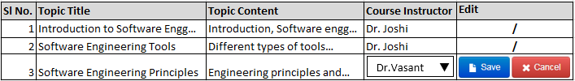

IonCUDOS Logo
Your College of Engineering, Place.
Computer Science of Engineering
College Logo
Home
Configuration
Delivery
Reports
Feedback
Manage Course Instructor
Click on edit to change Course Instructor
Button will be freeze after user ‘Accept’ in the modal. To re-open user has to click on edit & click on ‘Update’
Admin / Chairman / Program Owner / Course Owner Login

Slide 8
Assignment Open in slideshow mode (f5)

Slide 9





IonCUDOS Logo
Your College of Engineering, Place.
Computer Science of Engineering
College Logo
Home
Configuration
Delivery
Reports
Feedback
Assignment List
Curriculum:*
B.E. in CSE 2013-2017
Term:*
5 - Semester
Course:*
Data Communi
Section:*
A
Add Assignment Head
Assignment Head : *
Enter Assignment Head
Initiate Date : *
Due Date : *
Total Marks :
Instructions :

Slide 10
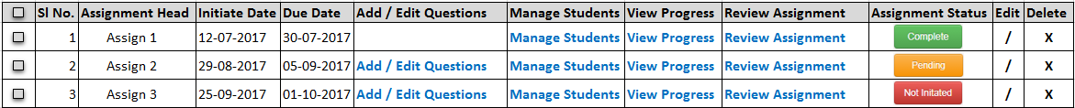
IonCUDOS Logo
Your College of Engineering, Place.
Computer Science of Engineering
College Logo
Home
Configuration
Delivery
Reports
Feedback
Assignment List
Curriculum:*
B.E. in CSE 2013-2017
Term:*
5 - Semester
Course:*
Data Communi
Section:*
A
Add / Edit Questions
Add Assignment Head
Assignment Head : *
Assign 4
Initiate Date : *
End Date : *
Total Marks :
Instructions :

Slide 11

IonCUDOS Logo
Your College of Engineering, Place.
Computer Science of Engineering
College Logo
Home
Configuration
Delivery
Reports
Feedback
Add / Edit Assignment
Curriculum: B.E. in CSE 2013-2017
Term: 5 - Semester
Course: Data Communication
Section: A
Assignment Head: Assign 2
Add Assignment
Sl No. :*
1
Assignment Question :*
Course Outcomes :
Select CO
Performance Indicators :
Select PI
Topics : *
Select Topic
Topic Learning Outcomes :
Select TLO
Bloom’s Level :
Select Bloom’s Level
Difficulty Level :
Select Difficulty Level
Total Marks :
10.00 / 20.00
Question Type :
Select Question Type
Marks :*
Enter Marks

Slide 12
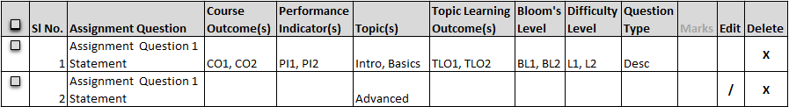



IonCUDOS Logo
Your College of Engineering, Place.
Computer Science of Engineering
College Logo
Home
Configuration
Delivery
Reports
Feedback
Add / Edit Assignment
Curriculum: B.E. in CSE 2013-2017
Term: 5 - Semester
Course: Data Communication
Section: A
Assignment Head: Assign 2
Edit Assignment
Sl No. :
1
Assignment Question :*
Course Outcomes :
CO1, CO3, CO5
What is meant by Data communication?
Performance Indicators :
PI2, PI4
Topics : *
Intro, Basics
Topic Learning Outcomes :
TLO3, TLO4
Bloom’s Domain :
BL2, BL4
Difficulty Level :
L2, L4
Total Marks :
10.00 / 20.00
Question Type :
Desc
Marks :*

Slide 13
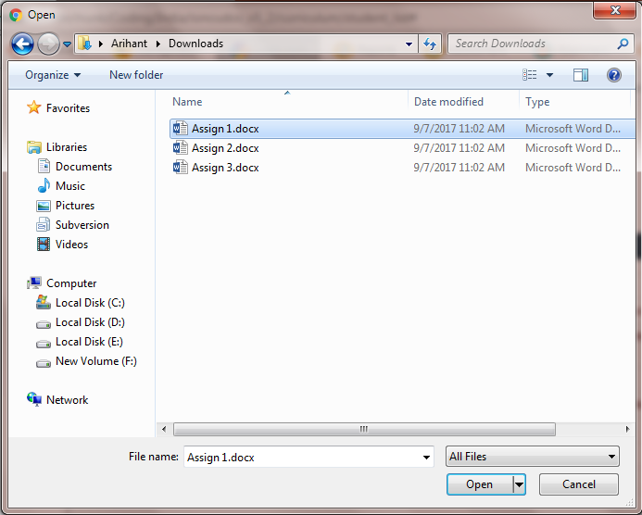
IonCUDOS Logo
Your College of Engineering, Place.
Computer Science of Engineering
College Logo
Home
Configuration
Delivery
Reports
Feedback
Add / Edit Assignment
Curriculum: B.E. in CSE 2013-2017
Term: 5 - Semester
Course: Data Communication
Section: A
Assignment Head: Assign 2
Add Assignment
Sl No. :
1
Assignment Question :*
Course Outcomes :
Select CO
Performance Indicators :
Select PI
Topics : *
Select Topic
Topic Learning Outcomes :
Select TLO
Bloom’s Level :
Select Bloom’s Level
Difficulty Level :
Select Difficulty Level
Total Marks :
10.00 / 20.00
Question Type :
Select Question Type
Marks :*
Enter Marks

Slide 14
IonCUDOS Logo
Your College of Engineering, Place.
Computer Science of Engineering
College Logo
Home
Configuration
Delivery
Reports
Feedback
Add / Edit Assignment
Curriculum: B.E. in CSE 2013-2017
Term: 5 - Semester
Course: Data Communication
Section: A
Assignment Head: Assign 2
Edit Assignment
Sl No. :
1
Assignment Question :
Course Outcomes :
Select CO
Performance Indicators :
Select PI
Topics : *
Select Topic
Topic Learning Outcomes :
Select TLO
Bloom’s Domain :
Select Bloom’s Level
Difficulty Level :
Select Difficulty Level
Total Marks :
10.00 / 20.00
Question Type :
Select Question Type
Marks :*

Slide 15
IonCUDOS Logo
Your College of Engineering, Place.
Computer Science of Engineering
College Logo
Home
Configuration
Delivery
Reports
Feedback
Add / Edit Assignment
Curriculum: B.E. in CSE 2013-2017
Term: 5 - Semester
Course: Data Communication
Section: A
Assignment Head: Assign 2
Edit Assignment
Sl No. :
1
Assignment Question :
Course Outcomes :
CO1, CO2
Performance Indicators :
PI2, PI4
Topics : *
Intro, Basics
Topic Learning Outcomes :
TLO3, TLO5
Bloom’s Domain :
BL2, BL4
Difficulty Level :
L4
Total Marks :
10.00 / 20.00
Question Type :
Marks :*

Slide 16
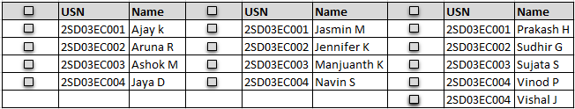
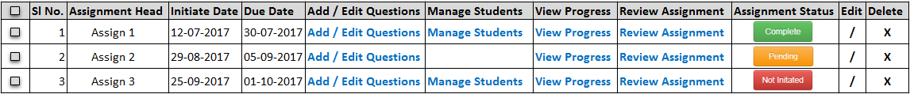


IonCUDOS Logo
Your College of Engineering, Place.
Computer Science of Engineering
College Logo
Home
Configuration
Delivery
Reports
Feedback
Manage Students
Assignment List
Curriculum:*
B.E. in CSE 2013-2017
Term:*
5 - Semester
Course:*
Data Communi
Section:*
A
Manage Students
Add Assignment Head
Assignment Head : *
Initiate Date : *
End Date : *
Total Marks :
Instructions :

Slide 17
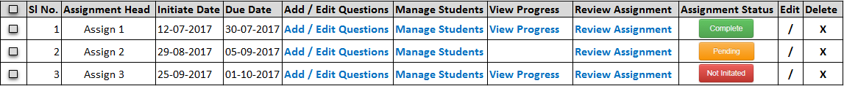

IonCUDOS Logo
Your College of Engineering, Place.
Computer Science of Engineering
College Logo
Home
Configuration
Delivery
Reports
Feedback
Manage Students
Assignment List
Curriculum:*
B.E. in CSE 2013-2017
Term:*
5 - Semester
Course:*
Data Communi
Section:*
A
Total Progress in %
List of Students who have not responded
View Progress
List of Students who have responded
Add Assignment Head
Assignment Head : *
Initiate Date : *
End Date : *
Total Marks :
Instructions :

Slide 18
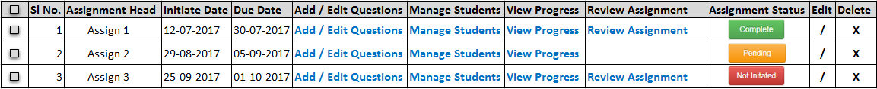
IonCUDOS Logo
Your College of Engineering, Place.
Computer Science of Engineering
College Logo
Home
Configuration
Delivery
Reports
Feedback
Assignment List
Curriculum:*
B.E. in CSE 2013-2017
Term:*
5 - Semester
Course:*
Data Communi
Section:*
A
Review Assignment
Add Assignment Head
Assignment Head : *
Initiate Date : *
End Date : *
Total Marks :
Instructions :

Slide 19
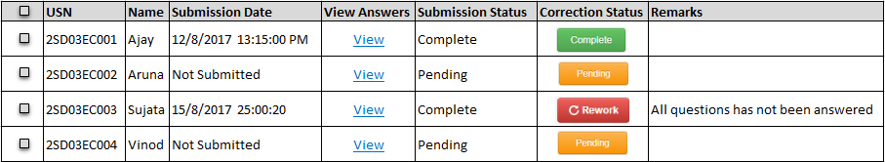
IonCUDOS Logo
Your College of Engineering, Place.
Computer Science of Engineering
College Logo
Home
Configuration
Delivery
Reports
Feedback
Review Assignment List
Curriculum: B.E in CSE 2013-2017 Term: 5 - Semester Course: Data Communication (CSC315) Topic: Introduction Section: A
Type: Assignment Assignment Head: Assign I Initiate Date: 29-08-2017 End Date: 05-09-2017 Total Marks: 20

Slide 20
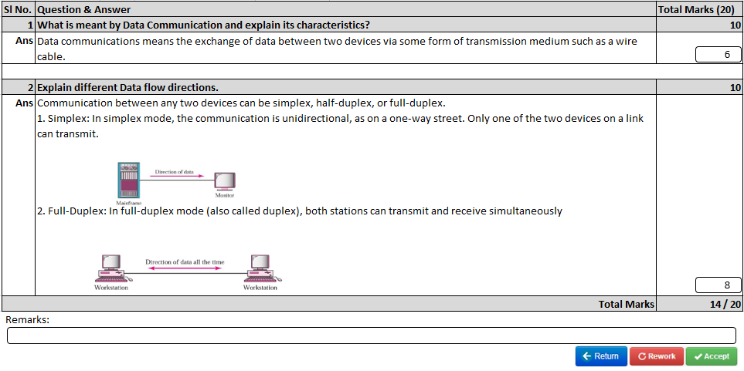
IonCUDOS Logo
Your College of Engineering, Place.
Computer Science of Engineering
College Logo
Home
Configuration
Delivery
Reports
Feedback
Review Answers

Slide 21
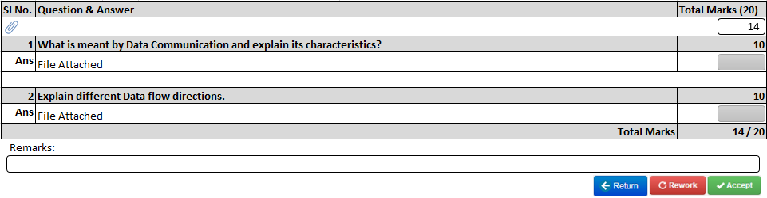
IonCUDOS Logo
Your College of Engineering, Place.
Computer Science of Engineering
College Logo
Home
Configuration
Delivery
Reports
Feedback
Review Answers
Attached File Name

Slide 22
Course Dropdown – On tooltip, display the course code of each course.
Marks in dull colors indicate that Marks entry is mandatory and will be displayed only if Total Marks is set while creating Assignment Head. Total Marks are decimal with 2 digit precision and are right aligned.
SL No. - Initially it will be 1 (one), after user adds first question automatically it will be set to 2. Validation is not done. User can use the same number to set two questions.
Bulk upload can be done only once. Once the bulk upload is complete Add Assignment section will be hidden. User can click on edit button to re-upload wherein Assignment Question section will be disabled. On bulk upload, no need to click on save button. If there are no questions only then bulk upload can be done
User can either opt for single question add or bulk import. Not both.
Provision for sys-admin to control which drop-downs & columns to be shown and which one to hide (only optional ones can be hidden)
If user clicks Cancel button instead of Update button, display Add Assignment section along with Save and Reset buttons.
Assignment Head dropdown beside section dropdown (or in edit section) should appear only if user add second Assignment head

Slide 23
User can add/edit/delete any question if none of the student has attempted that question. If any student has attempted the question that was edited by faculty then that particular question gets highlighted in the student module. If user deletes any question then student answer will also be deleted. Student should get notification.
Delete button will appear only when check box is selected
Prefix is missing while displaying student name
In manage student module, checkbox are hidden as of now. They are meant for faculty who wish to mark all students have submitted there assignment without correcting any of them or those who want to give full marks to all students without correcting them.

Slide 24
Student take Assignment Open in slideshow mode (f5)

Slide 25
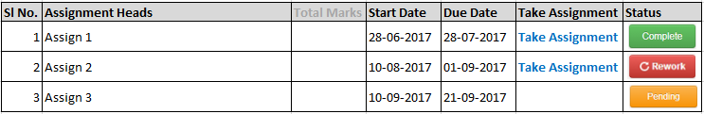
IonCUDOS Logo
Your College of Engineering, Place.
Computer Science of Engineering
College Logo
Home
Configuration
Delivery
Reports
Feedback
My Assignment List
Curriculum:*
B.E. in CSE 2013-2017
Term:*
5 - Semester
Course:*
Data Communication
Take Assignment

Slide 26
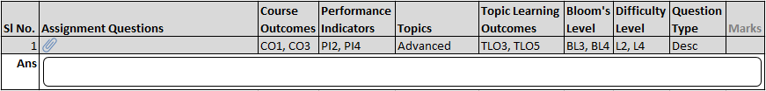



IonCUDOS Logo
Your College of Engineering, Place.
Computer Science of Engineering
College Logo
Home
Configuration
Delivery
Reports
Feedback
Take Assignment
Curriculum: B.E in CSE 2013-2017 Term: 5 - Semester Course: Data Communication (CSC315) Section: A
Type: Assignment Assignment Head: Assign 2 Initiate Date: 10-09-2017 End Date: 21-09-2017 Total Marks: 20
Answer
Upload
URL
Assignment Questions – File Name

Slide 27
IonCUDOS Logo
Your College of Engineering, Place.
Computer Science of Engineering
College Logo
Home
Configuration
Delivery
Reports
Feedback
Take Assignment
Curriculum: B.E in CSE 2013-2017 Term: 5 - Semester Course: Data Communication (CSC315) Section: A
Type: Assignment Assignment Head: Assign 2 Initiate Date: 10-09-2017 End Date: 21-09-2017 Total Marks: 20
Answer
Upload
URL
Upload your file here…
C:\Intel\Projects\Sample Project File.doc
Upload
Note: Files allowed are .doc, docx, xls, xlsx, jpg, png, txt, ppt, pptx, pdf, odt. Maximum file size allowed is 10MB.

Slide 28
IonCUDOS Logo
Your College of Engineering, Place.
Computer Science of Engineering
College Logo
Home
Configuration
Delivery
Reports
Feedback
Take Assignment
Curriculum: B.E in CSE 2013-2017 Term: 5 - Semester Course: Data Communication (CSC315) Section: A
Type: Assignment Assignment Head: Assign 2 Initiate Date: 10-09-2017 End Date: 21-09-2017 Total Marks: 20
Answer
Upload
URL
Paste URL here…
https://www.youtube.com/watch?v=heeH2kDtdWA

Slide 29
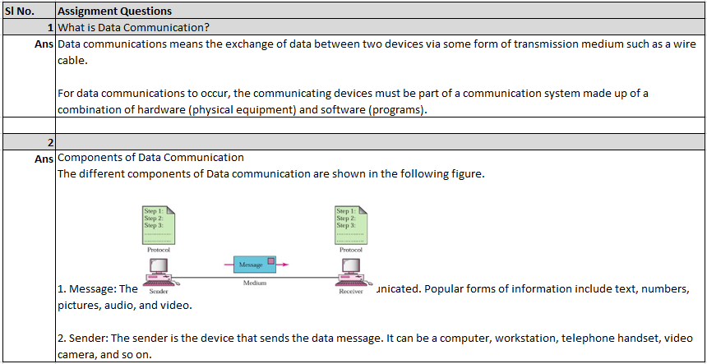
IonCUDOS Logo
Your College of Engineering, Place.
Computer Science of Engineering
College Logo
Home
Configuration
Delivery
Reports
Feedback
Take Assignment
Answer
Upload
URL

Slide 30
IonCUDOS Logo
Your College of Engineering, Place.
Computer Science of Engineering
College Logo
Home
Configuration
Delivery
Reports
Feedback
Take Assignment
Answer
Upload
URL
Upload your file here…
C:\Intel\Projects\Sample Project File.doc
Upload
Note: Files allowed are .doc, docx, xls, xlsx, jpg, png, txt, ppt, pptx, pdf, odt. Maximum file size allowed is 10MB.
View Assignment Questions

Slide 31
IonCUDOS Logo
Your College of Engineering, Place.
Computer Science of Engineering
College Logo
Home
Configuration
Delivery
Reports
Feedback
Take Assignment
Answer
Upload
URL
Paste URL here…
https://www.youtube.com/watch?v=heeH2kDtdWA
View Assignment Questions

Slide 32
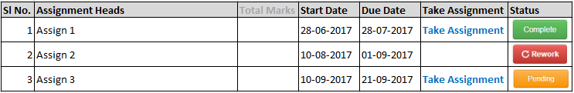
IonCUDOS Logo
Your College of Engineering, Place.
Computer Science of Engineering
College Logo
Home
Configuration
Delivery
Reports
Feedback
My Assignment List
Curriculum:*
B.E. in CSE 2013-2017
Term:*
5 - Semester
Course:*
Data Communication
Take Assignment

Slide 33
CO, PI, Topic, TLO, Bloom’s Level, Difficulty Level, Question Type should be configurable. College can opt to show or hide these columns to students - configurable
Display CO, PI, TLO, Bloom’s Level full form in tooltip for students.
Total Marks will be displayed to students only if faculty has set marks for the assignment.
Student can submit his/her assignment only once.
For students to write answer for the questions, TinyMCE will open only when student clicks on edit icon in the answer section.
Display Instruction / Note to students if its filled by faculty when they take up assignment
Rework will highlighted to all students if faculty add/edit/delete any question - If faculty add/edit/delete any question or re-upload a file it can be highlighted.

Slide 34
Course Materials upload / share workflow
Course Instructors share course related materials with students
Students will be able to view & download the course materials

Slide 35



Folder structure
../uploads
../course_materials
../curricula
../course
../faculty
../student
…/files (with timestamp)

Slide 36
Share Course material Open in slideshow mode (f5)

Slide 37
IonCUDOS Logo
Your College of Engineering, Place.
Computer Science of Engineering
College Logo
Home
Configuration
Delivery
Reports
Feedback
Share Course Materials List
Curriculum:*
B.E. in CSE 2013-2017
Term:*
5 - Semester
Course:*
Data Communic
Section:*
A, B
Add Course Material
File :*
Browse
Topics :
Select Topic
Additional Information :
0 to 2000

Slide 38
IonCUDOS Logo
Your College of Engineering, Place.
Computer Science of Engineering
College Logo
Home
Configuration
Delivery
Reports
Feedback
Share Course Materials List
Curriculum:*
B.E. in CSE 2013-2017
Term:*
5 - Semester
Course:*
Data Communic
Section:*
A, B
Add Course Material
Reference / Path :*
Topics :
Select Topic
Additional Information :
0 to 2000

Slide 39
Course Instructor will be able to view Curriculum, Term, Course and Sections related to them.
Course code to be displayed for each course in the drop-down
Section drop-down will be multi select.
Topic drop-down will be multi-select

Slide 40
Student receive course materials Open in slideshow mode (f5)

Slide 41

IonCUDOS Logo
Your College of Engineering, Place.
Computer Science of Engineering
College Logo
Home
Configuration
Delivery
Reports
Feedback
Shared Course Materials
Curriculum:*
B.E. in CSE 2013-2017
Term:*
5 - Semester
Course:*
Data Communic

Slide 42

overall…..
In all the table sort option (Ascending or Descending) are required…
Date validation is required – Initiate Date and Due Date
Next level – Software has to identify and inform user which all assignments can be considered for Attainment (All students are connected to that assignment)
Localization & SAAS to be taken into consideration during UI & Database design.

Slide 43
caution!!!
If student logs in and then paste the URL used by faculty (any module) then he/she can get access to the system if proper permissions are not set in the controller
Standard class, id and name should be followed, easy to track in which module they exist. Hence each module should have a specific code

Slide 44
Course Instructor - Lesson schedule Open in slideshow mode (f5)

Slide 45
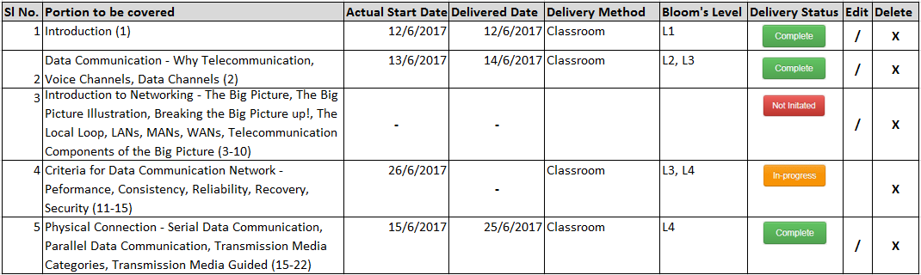
IonCUDOS Logo
Your College of Engineering, Place.
Computer Science of Engineering
College Logo
Home
Configuration
Delivery
Reports
Feedback
Lesson Schedule
Curriculum:*
B.E. in CSE 201
Term:*
5 - Semester
Course:*
Data Communic
Topic:*
Introduction
Section:*
A, B
Add Portion to be covered
Sl No. : *
6
Delivery Method :
Select Delivery Metho
Bloom’s Level :
Select Bloom’s Level
Actual Start Date :
_ _ / _ _ / _ _ _ _
Completion Date :
_ _ / _ _ / _ _ _ _
Portion to be : * covered.

Slide 46
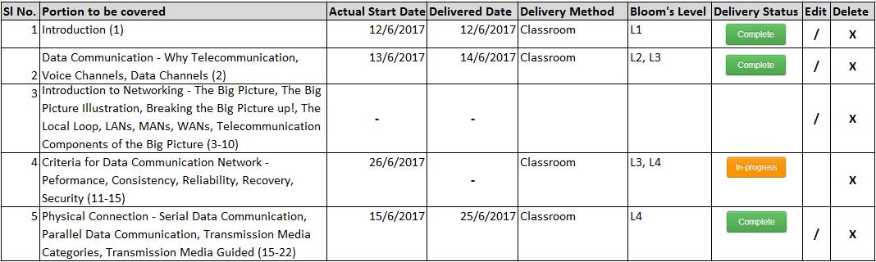

IonCUDOS Logo
Your College of Engineering, Place.
Computer Science of Engineering
College Logo
Home
Configuration
Delivery
Reports
Feedback
Lesson Schedule
Curriculum:*
B.E. in CSE 201
Term:*
5 - Semester
Course:*
Data Communic
Topic:*
Introduction
Section:*
A, B
Add Portion to be covered
Sl No. : *
6
Delivery Method :
Select Delivery Metho
Bloom’s Level :
Select Bloom’s Level
Actual Start Date :
_ _ / _ _ / _ _ _ _
Completion Date :
_ _ / _ _ / _ _ _ _
Topic content has been initiated x
Portion to be : * covered.

Slide 47
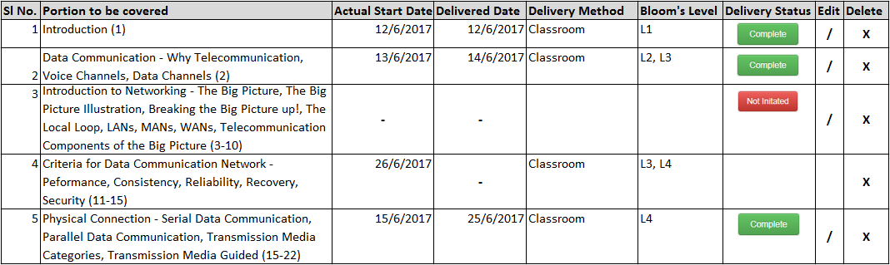

IonCUDOS Logo
Your College of Engineering, Place.
Computer Science of Engineering
College Logo
Home
Configuration
Delivery
Reports
Feedback
Lesson Schedule
Curriculum:*
B.E. in CSE 201
Term:*
5 - Semester
Course:*
Data Communic
Topic:*
Introduction
Section:*
A, B
Add Portion to be covered
Sl No. : *
6
Delivery Method :
Select Delivery Metho
Bloom’s Level :
Select Bloom’s Level
Actual Start Date :
_ _ / _ _ / _ _ _ _
Completion Date :
_ _ / _ _ / _ _ _ _
Topic content has been delivered x
Portion to be : * covered.

Slide 48
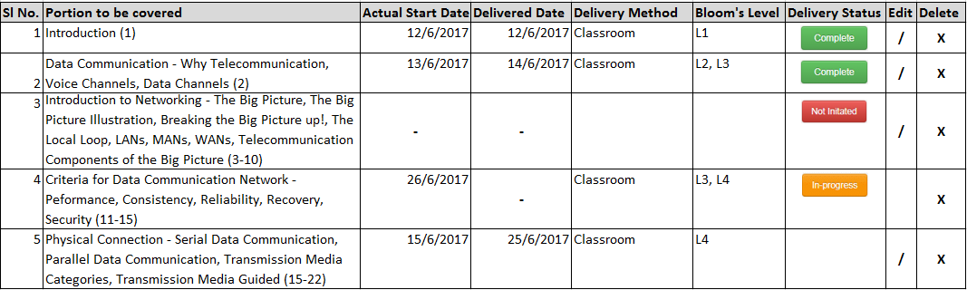


IonCUDOS Logo
Your College of Engineering, Place.
Computer Science of Engineering
College Logo
Home
Configuration
Delivery
Reports
Feedback
Lesson Schedule
Curriculum:*
B.E. in CSE 201
Term:*
5 - Semester
Course:*
Data Communic
Topic:*
Introduction
Section:*
A, B
Re-open Confirmation
Are you sure you want to re-open the topic content?
Status: * In-progress Not initiated
Add Portion to be covered
Sl No. : *
6
Delivery Method :
Select Delivery Metho
Bloom’s Level :
Select Bloom’s Level
Actual Start Date :
_ _ / _ _ / _ _ _ _
Completion Date :
_ _ / _ _ / _ _ _ _
Portion to be : * covered.

Slide 49
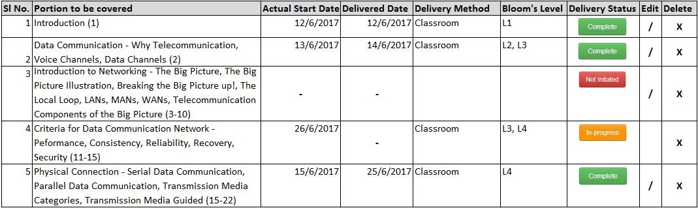
IonCUDOS Logo
Your College of Engineering, Place.
Computer Science of Engineering
College Logo
Home
Configuration
Delivery
Reports
Feedback
Lesson Schedule
Curriculum:*
B.E. in CSE 201
Term:*
5 - Semester
Course:*
Data Communic
Topic:*
Introduction
Section:*
A, B
Add Portion to be covered
Sl No. : *
6
Delivery Method :
Select Delivery Metho
Bloom’s Level :
Select Bloom’s Level
Actual Start Date :
_ _ / _ _ / _ _ _ _
Completion Date :
_ _ / _ _ / _ _ _ _
Portion to be : * covered.

Slide 50
IonCUDOS Logo
Your College of Engineering, Place.
Computer Science of Engineering
College Logo
Home
Configuration
Delivery
Reports
Feedback
Lesson Schedule
Curriculum:*
B.E. in CSE 201
Term:*
5 - Semester
Course:*
Data Communic
Topic:*
Introduction
Section:*
A, B
Edit Portion to be covered
Sl No. : *
1
Delivery Method :
Classroom
Bloom’s Level :
L1, L2
Actual Start Date :
_ _ / _ _ / _ _ _ _
Completion Date :
_ _ / _ _ / _ _ _ _
Portion to be : * covered.
Introduction (1)

Slide 51
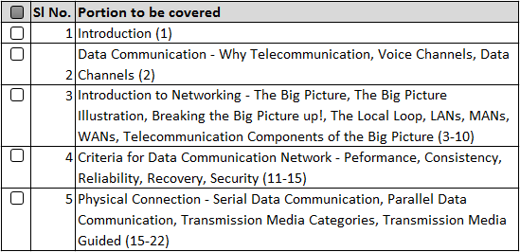
IonCUDOS Logo
Your College of Engineering, Place.
Computer Science of Engineering
College Logo
Home
Configuration
Delivery
Reports
Feedback
Lesson Schedule
Curriculum:*
B.E. in CSE 201
Term:*
5 - Semester
Course:*
Data Communic
Topic:*
Introduction
Section:*
A, B
Updated Lesson Schedule
Lesson Schedule Content has been update click here to view changes
Topic: Digital communication
Are you sure you want to override the statement?
Add Portion to be covered
Sl No. : *
6
Delivery Method :
Select Delivery Metho
Bloom’s Level :
Select Bloom’s Level
Actual Start Date :
_ _ / _ _ / _ _ _ _
Completion Date :
_ _ / _ _ / _ _ _ _
Portion to be : * covered.

Slide 52
Prerequisite – Manage Course Instructor task should be completed.
Admin, Chairman, Program Owner & Course Owner will be able to view all topics.
Course Instructor will be able to view Topics related to him/her
Multi-select dropdown for section/division.
Open Question – do we need to provide – Planned start and End Date??? (What if course owner has not filled lesson schedule).
Serial Number auto increment and also allow user to change it.
Serial Number box characters that are allowed – Numbers & Hyphen (space, alphabets, symbols not allowed)
Add/Edit Portion to be covered – allow user to add previous dates
Calendar should allow user to type date => _ _/_ _/_ _ _ _ (DD/MM/YYYY) along with date selection.
Delivery Method and Bloom’s Level can be shown or hidden based on admin settings.

Slide 53
Re-open => Initiate or In-progress (slide 48). If Initiate option is selected then, actual start date and completion date columns will become blank in the list page. If In-progress option is selected, completion date column will become blank in the list page.
Auto generated code/flag to be used for each lesson schedule – backend.
Display only those Lesson Schedule statement that has been edited by Course instructor.
Delivery Method and Bloom’s Domain are multi-select
Once lesson schedule content has been updated stop animation effect, but do not hide ‘click here’ option
Due to some reason if the user is not able to initiate / close topic content display error message
Display newly added content in different color.

Slide 54
Activity Based Open in slideshow mode (f5)

Slide 55
Different Types of Activity Based Learning
Dramatization – Conversion into dramatic form or reconstruction of an event, novel, story etc in a form suitable for dramatic presentation
Quizzes
Group Discussion
Role Play – Enacting some situations or playing the role of things, persons, characters etc.
Educational Games
Brainstorming
Problem Solving
Debates
Discovery learning
Project
Field Work
Experimentation
Concept Mapping – presenting different things in hierarchal fashion with most inclusive
Peer-to-Peer critiquing

Slide 56
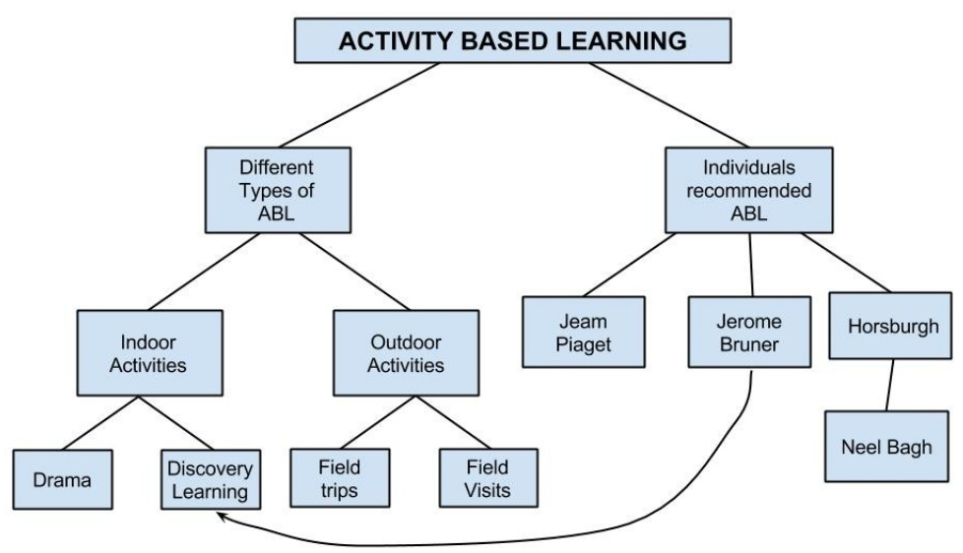

Slide 57
Manage Activities
Course Instructor create Activity & add Rubrics
Course Instructor assign activity to students
Students take up and submit activity assigned to them
Seminar / PPT / etc..
Sent for rework
Course Instructor assign marks for each student
Faculty reviews
student activity

Slide 58
As Course Instructor

Slide 59
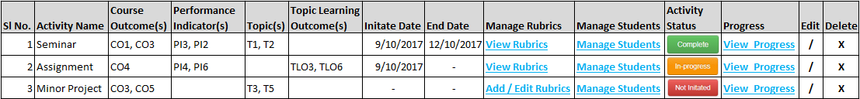
IonCUDOS Logo
Your College of Engineering, Place.
Computer Science of Engineering
College Logo
Home
Configuration
Delivery
Reports
Feedback
Activities List
Curriculum:*
B.E. in CSE 201
Term:*
5 - Semester
Course:*
Data Communic
Section:*
A, B
Topic:
Introduction
Add Activity
Activity Name : *
Select Activity Type
Activity Details :
Topics : *
Select Topic

Slide 60
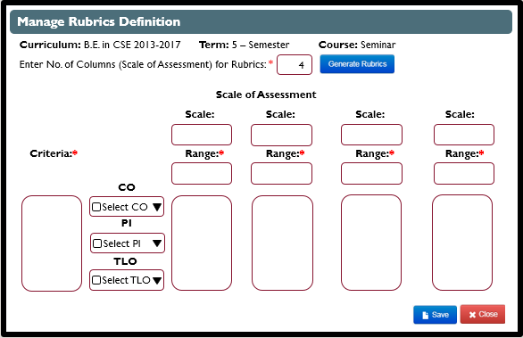


Manage Rubrics Definition
Curriculum: B.E. in CSE 2013-2017 Term: 5 – Semester Course: Seminar
Enter No. of Columns (Scale of Assessment) for Rubrics: *
4
Scale of Assessment
Scale: Scale: Scale: Scale:
Criteria:* Range:* Range:* Range:* Range:*
CO
Select CO
PI
Select PI
TLO
Select TLO

Slide 61
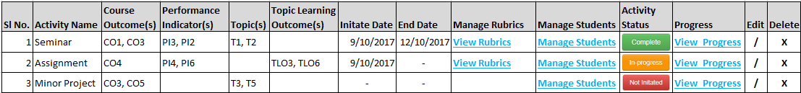
IonCUDOS Logo
Your College of Engineering, Place.
Computer Science of Engineering
College Logo
Home
Configuration
Delivery
Reports
Feedback
Activities List
Curriculum:*
B.E. in CSE 201
Term:*
5 - Semester
Course:*
Data Communic
Section:*
A, B
Topic:
Introduction
Add/Edit Rubrics
Add Activity
Activity Name : *
Select Activity Type
Activity Details :
Topics : *
Select Topic

Slide 62
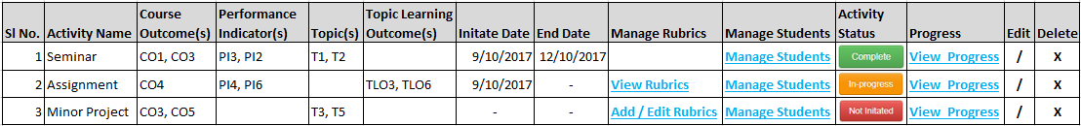
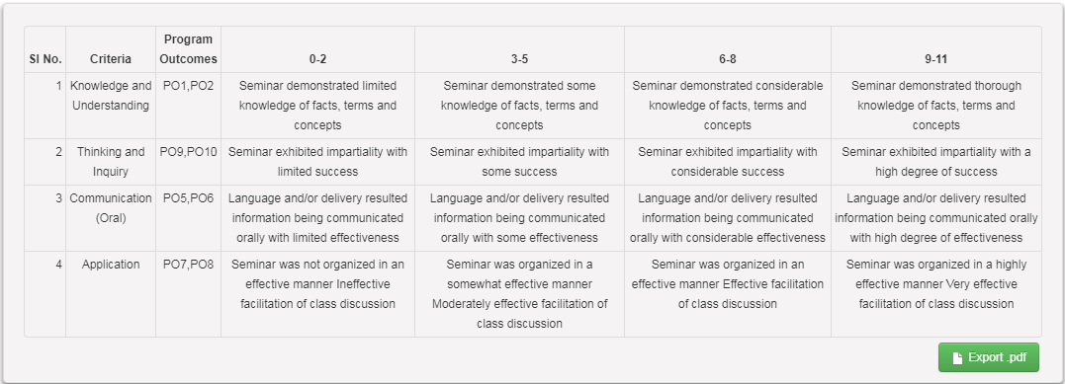



IonCUDOS Logo
Your College of Engineering, Place.
Computer Science of Engineering
College Logo
Home
Configuration
Delivery
Reports
Feedback
Activities List
Manage Rubrics Definition
Curriculum:*
B.E. in CSE 201
Term:*
5 - Semester
Course:*
Data Communic
Section:*
A, B
Topic:
Introduction
Curriculum: B.E. in CSE 2013-2017 Term: 5 – Semester Course: Seminar
View Rubrics
Generate Rubrics Confirmation
Curriculum: B.E. in CSE 2013-2017 Term: 5 – Semester Course: Seminar
Are you sure you want to delete all rubrics data?
Add Activity
Activity Name : *
Select Activity Type
Activity Details :
Topics : *
Select Topic

Slide 63
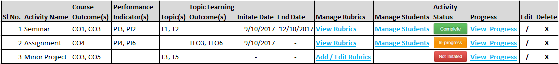

IonCUDOS Logo
Your College of Engineering, Place.
Computer Science of Engineering
College Logo
Home
Configuration
Delivery
Reports
Feedback
Activities List
Manage Students
Curriculum:*
B.E. in CSE 201
Term:*
5 - Semester
Course:*
Data Communic
Section:*
A, B
Topic:
Introduction
Manage Students
Add Activity
Activity Name : *
Select Activity Type
Activity Details :
Topics : *
Select Topic

Slide 64
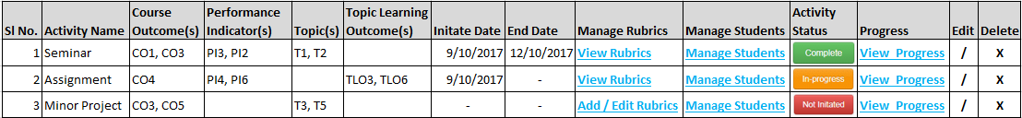
IonCUDOS Logo
Your College of Engineering, Place.
Computer Science of Engineering
College Logo
Home
Configuration
Delivery
Reports
Feedback
Activities List
Curriculum:*
B.E. in CSE 201
Term:*
5 - Semester
Course:*
Data Communic
Section:*
A, B
Topic:
Introduction
Edit Activity
Activity Name : *
Seminar
Activity Details :
Seminar on topic 2
Topics : *
T1, T3
Initiate Date : *
09 / 10 / 2017
End Date : *
12 / 10 / 2017

Slide 65
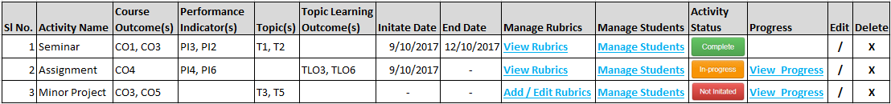
IonCUDOS Logo
Your College of Engineering, Place.
Computer Science of Engineering
College Logo
Home
Configuration
Delivery
Reports
Feedback
Activities List
Curriculum:*
B.E. in CSE 201
Term:*
5 - Semester
Course:*
Data Communic
Section:*
A, B
Topic:
Introduction
View Progress
Add Activity
Activity Name : *
Select Activity Type
Activity Details :
Topics : *
Select Topic

Slide 66
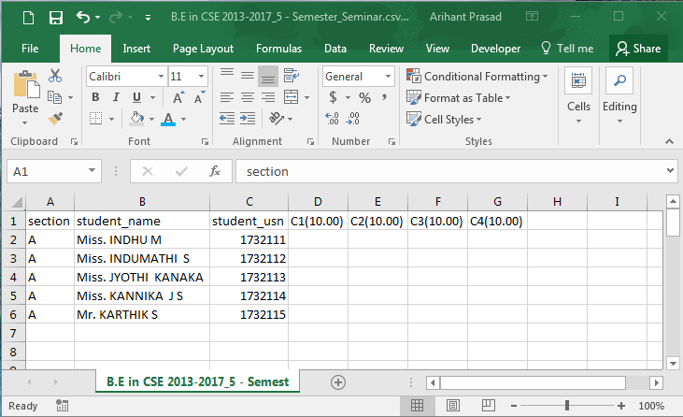


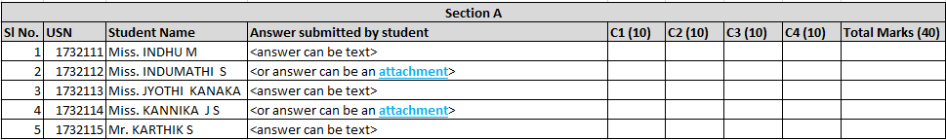
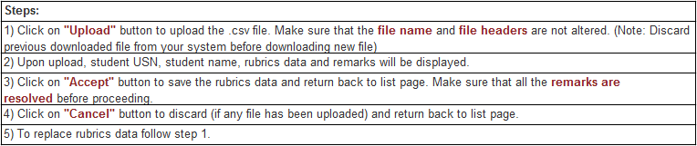
IonCUDOS Logo
Your College of Engineering, Place.
Computer Science of Engineering
College Logo
Home
Configuration
Delivery
Reports
Feedback
Activity Student Marks Import
Select Section
Student Details

Slide 67
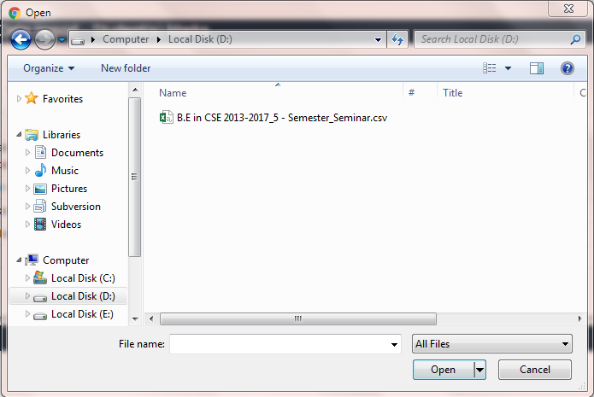
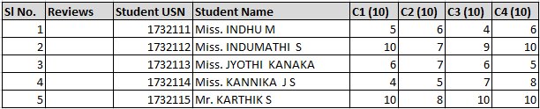
IonCUDOS Logo
Your College of Engineering, Place.
Computer Science of Engineering
College Logo
Home
Configuration
Delivery
Reports
Feedback
Activity Student Marks Import
Select Section
Student Details

Slide 68
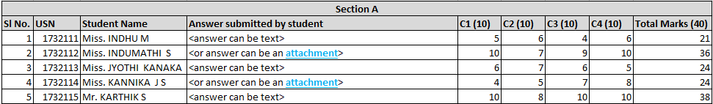
IonCUDOS Logo
Your College of Engineering, Place.
Computer Science of Engineering
College Logo
Home
Configuration
Delivery
Reports
Feedback
Activity Student Marks Import
Select Section
Student Details

Slide 69
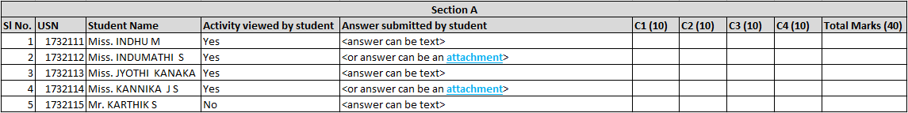
Optional

Slide 70
As student

Slide 71
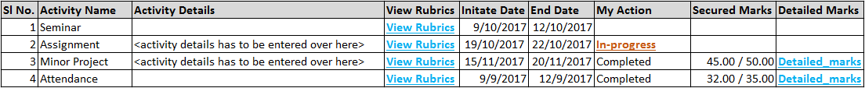
IonCUDOS Logo
Your College of Engineering, Place.
Computer Science of Engineering
College Logo
Home
Configuration
Delivery
Reports
Feedback
Activity List
Curriculum:*
B.E. in CSE 2013-2017
Term:*
5 - Semester
Course:*
Data Communication
Click_to_answer
Activity - Seminar
Answer Document URL
Seminar Details : *
0 to 2000

Slide 72
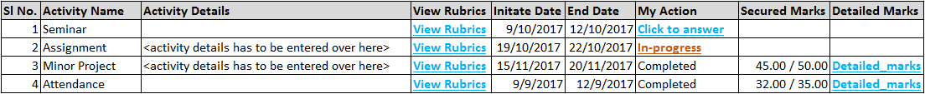
IonCUDOS Logo
Your College of Engineering, Place.
Computer Science of Engineering
College Logo
Home
Configuration
Delivery
Reports
Feedback
Activity List
Curriculum:*
B.E. in CSE 2013-2017
Term:*
5 - Semester
Course:*
Data Communication
Activity - Seminar
Answer Document URL
File :*
Browse
Additional Information :
0 to 2000

Slide 73
IonCUDOS Logo
Your College of Engineering, Place.
Computer Science of Engineering
College Logo
Home
Configuration
Delivery
Reports
Feedback
Activity List
Curriculum:*
B.E. in CSE 2013-2017
Term:*
5 - Semester
Course:*
Data Communication
Activity - Seminar
Answer Document URL
Reference / Path :*
Additional Information :
0 to 2000

Slide 74
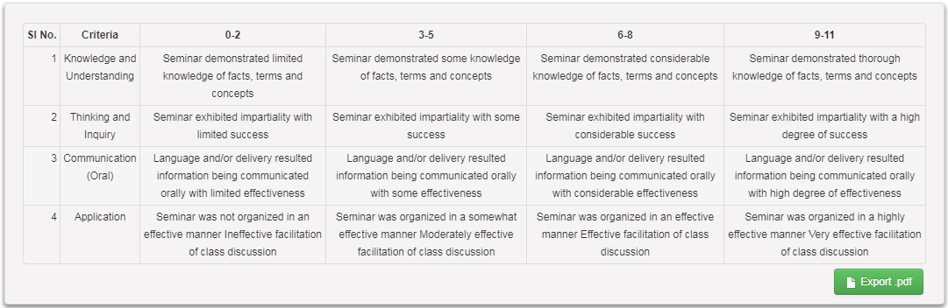
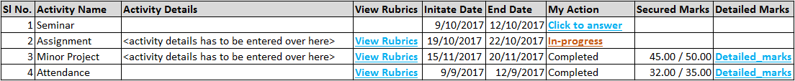
IonCUDOS Logo
Your College of Engineering, Place.
Computer Science of Engineering
College Logo
Home
Configuration
Delivery
Reports
Feedback
Activity List
View Rubrics
Curriculum:*
B.E. in CSE 2013-2017
Term:*
5 - Semester
Course:*
Data Communication
Activity Name: Seminar
View Rubrics

Slide 75
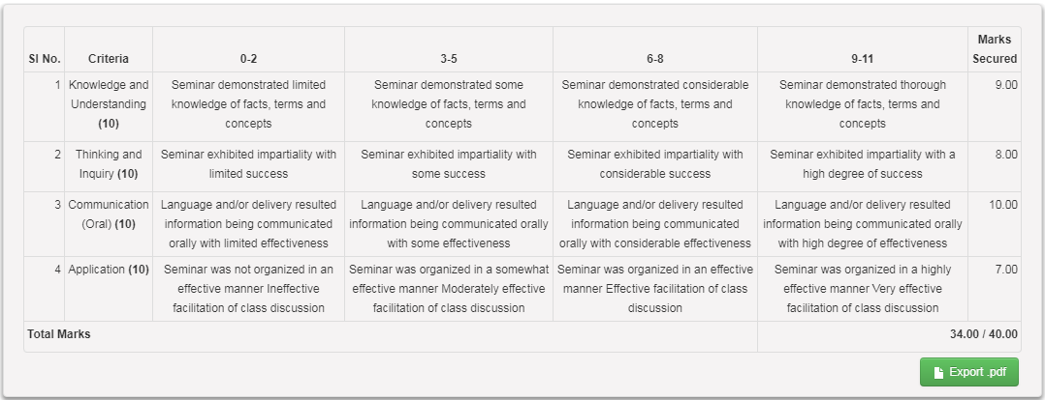
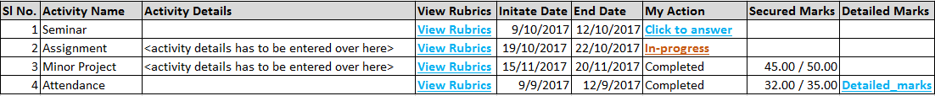
IonCUDOS Logo
Your College of Engineering, Place.
Computer Science of Engineering
College Logo
Home
Configuration
Delivery
Reports
Feedback
Activity List
View Detailed Marks
Curriculum:*
B.E. in CSE 2013-2017
Term:*
5 - Semester
Course:*
Data Communication
Activity Name: Seminar
Detailed_marks

Slide 76
indicate multi-select option
Topic dropdown is non-mandatory (on top right corner). Used for filtering
Activity question/details to be displayed in the tooltip.
Once rubrics are finalized Add / Edit Rubrics link will be replaced by View Rubrics link.
Course outcomes, Performance indicators and Topic learning outcomes are configurable. Handled at the organization level.
‘Not Initiated’ button will be activated only after adding rubrics. Display modal message for the same.
No. of columns while adding rubrics cannot be more than 10.
‘Complete’, ‘In-progress’ and ‘Not Initiated’ will follow Lesson Schedule process (refer 46, 47, 48)
After ‘Accept’ on marks upload display ‘View Marks’ button
Return icon should be - slide 68
Placeholder for all textboxes.

Slide 77
Activity Student Marks Import screen, if user selects one section (A or B) in the .csv selected section students will be displayed. If there is only one section allocated to user, by default that section should be displayed to the user.
Student USN can be alpha numeric.
All main tables (list page) should be check boxes in the beginning (first row).
71, 72, 73 – Cancel will hide Add Section.

Slide 78
Thank you ☺

Slide 79



IonCUDOS Logo
Your College of Engineering, Place.
Computer Science of Engineering
College Logo
Home
Configuration
Delivery
Reports
Feedback
Master Screen
Curriculum:*
B.E. in CSE 2013-2017
Term:*
5 - Semester
Course:*
Data Communi
Curriculum:*
B.E. in CSE 2013-2017
Term:*
5 - Semester
Course:*
Data Communi
Section:*
A

